Slide 1
Requirements Engineering

Slide 2
Requirements Engineering is the process of identifying, eliciting, analyzing, specifying, validating, and managing the needs and expectations of stakeholders for a software system.
Requirements Engineering Process
Feasibility Study
Requirements elicitation
Requirements specification
Requirements for verification and validation
Requirements management

Slide 3
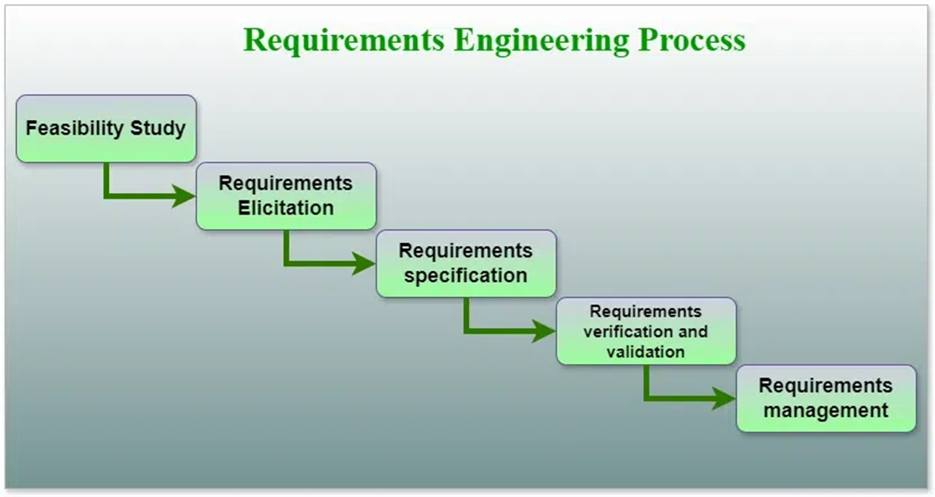

Slide 4
1. Feasibility Study
Technical Feasibility: In Technical Feasibility current resources both hardware software along required technology are analyzed/assessed to develop the project.
Operational Feasibility: In Operational Feasibility degree of providing service to requirements is analyzed along with how easy the product will be to operate and maintain after deployment.
Economic Feasibility: In the Economic Feasibility study cost and benefit of the project are analyzed.
Legal Feasibility: In legal feasibility, the project is ensured to comply with all relevant laws, regulations, and standards.
Schedule Feasibility: In schedule feasibility, the project timeline is evaluated to determine if it is realistic and achievable. Significant milestones are identified, and deadlines are established to track progress effectively. Resource availability is assessed to ensure that the necessary resources are accessible to meet the project schedule.

Slide 5
2. Requirements Elicitation
Requirements elicitation is the process of gathering information about the needs and expectations of stakeholders for a software system.
This is the first step in the requirements engineering process and it is critical to the success of the software development project.

Slide 6
Several techniques can be used to elicit requirements, including:
Interviews: These are one-on-one conversations with stakeholders to gather information about their needs and expectations.
Surveys: These are questionnaires that are distributed to stakeholders to gather information about their needs and expectations.
Focus Groups: These are small groups of stakeholders who are brought together to discuss their needs and expectations for the software system.
Observation: This technique involves observing the stakeholders in their work environment to gather information about their needs and expectations.
Prototyping: This technique involves creating a working model of the software system, which can be used to gather feedback from stakeholders and to validate requirements.

Slide 7
3. Requirements Specification
Requirements specification is the process of documenting the requirements identified in the analysis step in a clear, consistent, and unambiguous manner.
This step also involves prioritizing and grouping the requirements into manageable chunks.
ER diagrams, data flow diagrams(DFDs), function decomposition diagrams(FDDs), data dictionaries,

Slide 8
Several types of requirements are commonly specified in this step, including
Functional Requirements: These describe what the software system should do. They specify the functionality that the system must provide, such as input validation, data storage, and user interface.
Non-Functional Requirements: These describe how well the software system should do it. They specify the quality attributes of the system, such as performance, reliability, usability, and security.
Constraints: These describe any limitations or restrictions that must be considered when developing the software system.
Acceptance Criteria: These describe the conditions that must be met for the software system to be considered complete and ready for release.

Slide 9
4. Requirements Verification and Validation
Verification: It refers to the set of tasks that ensures that the software correctly implements a specific function.
Validation: It refers to a different set of tasks that ensures that the software that has been built is traceable to customer requirements. If requirements are not validated, errors in the requirement definitions would propagate to the successive stages resulting in a lot of modification and rework.
The main steps for this process include:
The requirements should be consistent with all the other requirements i.e. no two requirements should conflict with each other.
The requirements should be complete in every sense.
The requirements should be practically achievable.

Slide 10
Verification is checking that the requirements are complete, consistent, and accurate.
Validation is the process of checking that the requirements meet the needs and expectations of the stakeholders. It involves testing the requirements to ensure that they are valid and that the software system being developed will meet the needs of the stakeholders..
Verification and Validation is an iterative process that occurs throughout the software development life cycle.
It is important to involve stakeholders and the development team in the V&V process to ensure that the requirements are thoroughly reviewed and tested.

Slide 11
5. Requirements Management
Requirements management is the process of managing the requirements throughout the software development life cycle, including tracking and controlling changes, and ensuring that the requirements are still valid and relevant.
The goal of requirements management is to ensure that the software system being developed meets the needs and expectations of the stakeholders and that it is developed on time, within budget, and to the required quality.

Slide 12
Several key activities are involved in requirements management, including:
Tracking and controlling changes: This involves monitoring and controlling changes to the requirements throughout the development process, including identifying the source of the change, assessing the impact of the change, and approving or rejecting the change.
Version control: This involves keeping track of different versions of the requirements document and other related artifacts.
Traceability: This involves linking the requirements to other elements of the development process, such as design, testing, and validation.
Communication: This involves ensuring that the requirements are communicated effectively to all stakeholders and that any changes or issues are addressed promptly.
Monitoring and reporting: This involves monitoring the progress of the development process and reporting on the status of the requirements.

Slide 13
Tools Involved in Requirement Engineering
Observation report
Questionnaire ( survey, poll )
Use cases
User stories
Requirement workshop
Mind mapping
Roleplaying
Prototyping

Slide 14
Advantages of Requirements Engineering Process
Helps ensure that the software being developed meets the needs and expectations of the stakeholders
Can help identify potential issues or problems early in the development process, allowing for adjustments to be made before significant
Helps ensure that the software is developed in a cost-effective and efficient manner
Can improve communication and collaboration between the development team and stakeholders

Slide 15
Disadvantages of Requirements Engineering Process
Changes in requirements can lead to delays and increased costs in the development process.
It can be time-consuming and expensive, especially if the requirements are complex.
Requirements may change over time, which can result in delays and additional costs.

Slide 16
Stages in Software Engineering Process
Elicitation: In this stage, the requirements are gathered from various stakeholders such as customers, users, and domain experts. The aim is to identify the features and functionalities that the software system should provide.
Analysis: In this stage, the requirements are analyzed to determine their feasibility, consistency, and completeness. The aim is to identify any conflicts or contradictions in the requirements and resolve them.
Specification: In this stage, the requirements are documented in a clear, concise, and unambiguous manner. The aim is to provide a detailed description of the requirements that can be understood by all stakeholders.
Validation: In this stage, the requirements are reviewed and validated to ensure that they meet the needs of all stakeholders. The aim is to ensure that the requirements are accurate, complete, and consistent.
Management: In this stage, the requirements are managed throughout the software development lifecycle. The aim is to ensure that any changes or updates to the requirements are properly documented and communicated to all stakeholders.

